Slide 1

What to expect from Year 7

Slide 2

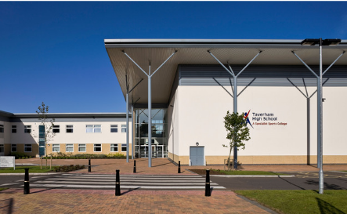
WELCOME!
We are really looking forward to welcoming you all to be part of our school community.
In this presentation you will find useful information, photos of people you will meet and places your child will discover in September.

Slide 3

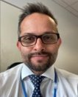
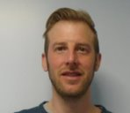
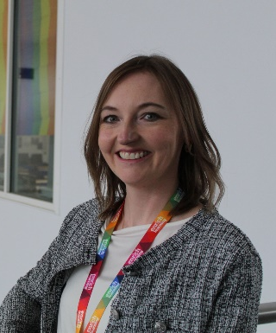

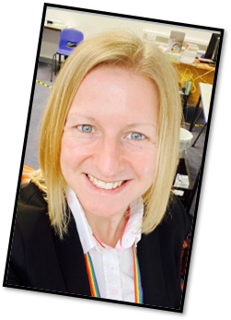
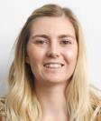
SENIOR
LEADERSHIP
TEAM
Mr. Hyett:
Assistant Head Teacher
Teaching and Learning
Mr. Yassin:
Head Teacher
Mr. Day:
Assistant Head Teacher
PD, equality and diversity
Miss. Ricketts:
Deputy Head Teacher
Safeguarding, behaviour and welfare
Mrs. Gardiner:
Assistant Head Teacher
Culture Rewards and Learning Behaviour
Mrs. Robertson Head of 6th Form
Ms. Webb
Assistant Head Teacher
Curriculum, assessment and data

Slide 4
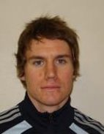
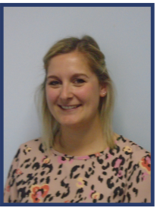
Mr. Blowers:
Behaviour Lead
My role is to review behaviour on a daily basis and support Head of Year in following up negative and positive behaviour points.
MEET
THE
TEAM
Miss Birkin
Head of Year 7
My role is to make sure students are happy, achieving and behaving in school. I will be there daily for any worries or stresses and regularly speak to parents and pastoral team.
Mrs. Gardiner:
Transition Lead
My role is to help with transitions to THS and make sure they're as smooth as possible. I work with students, parents and current teachers and am 1 of many people students can talk to.

Slide 5

WHO CAN
I SPEAK
TO?
Head of Year
(Miss Birkin)
The key roles of the Head of
Year are attendance, behaviour, bullying and welfare & guidance.
Transition Lead
(Mrs Gardiner)
The key role of the Transition Lead is creating a smooth transition
for you
Form Tutor -
They should be the first person you will turn to for help or advice. A Form Tutor's role is to care for you and monitoring your progress both academically and socially making sure you succeed. Please also let them or your HOY know, as soon as
possible, if there are any problems at home or medical issues.
Student Support
The role of student support is to
support welfare & guidance of our
students, their mental health &
wellbeing, safeguarding and to work
with external agencies/alternative
provision.
Behaviour Lead
(Mr. Blowers)
The key role of the Behaviour Lead is the welfare & guidance of students, seeking alternative provision &
promoting praise and rewards.

Slide 6
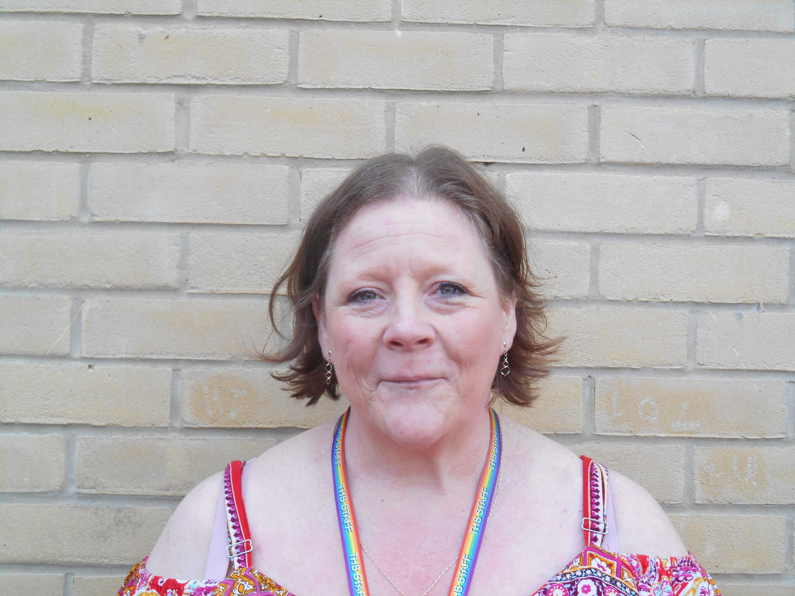
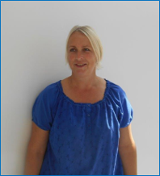
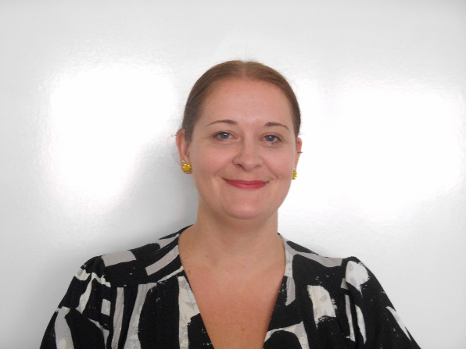
STUDENT
SUPPORT
Mrs. Sadler:
Student Support
Mrs. Killington:
Student Support
Our aim is to offer young people a safe environment where they feel supported to work through issues they face. I work with both students and their families with your Head of Year.
Mrs. Reynolds
Student Support

Slide 7
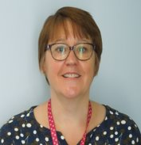
Mr. Day:
SENCO
MEET
THE SEND
TEAM
Mrs. Gray:
Assistant SENCO
We are here to help with learning and to help students make the most of their time at Taverham High School. Students may meet us in lessons, in Group Intervention work or around school. We are always happy to help and can be found in our student support area.

Slide 8
YEAR 7 TRANSITION DAYS
Wednesday 9th July
8.45am Pupils arrive to Sports Hall
9.00 – 10.35 Time with Form Tutors (Welcome Guide, PPT, Ice Breakers, Tour, Biometrics, Summer Work)
10.35 – 10.55 Break (on Astro)
10.55 – 11.55 Lesson 1
11.55 – 12.55 Lesson 2
12.55 – 1.40 Lunch (on Astro)
1.40 – 2.00 Time with Form Tutors
2.00 – 2.45 Lesson 3
2.45 Students leave from Sports Hall
Thursday 10th July
8.45am Pupils arrive to Sports Hall
9.00 – 9.35 Time with Form Tutors (Welcome Guide, PPT, Ice Breakers, Biometrics, Summer Work)
9.35 – 10.35 Lesson 4
10.35 – 10.55 Break
10.55 – 12.55 School Sports Partnership
12.55 – 1.40 Lunch
1.40 – 2.00 Time with Form Tutors
2.00 – 2.45 Assembly (TGR/DBR)
2.45 – 3.00 Students leave from the Main Hall

Slide 9

ELF PROGRAMME
An ELF is a trained peer working with the new Y7’s each year. Each Elf member is allocated to a year 7 form. They support the form tutor one day a week organising activities and getting to know the students.
The Elf team are visible in and around school as they wear a bright green lanyard, if students see them with this on it means they are available to talk to. Each Elf also has a designated day to be on duty at lunchtime.

Slide 10
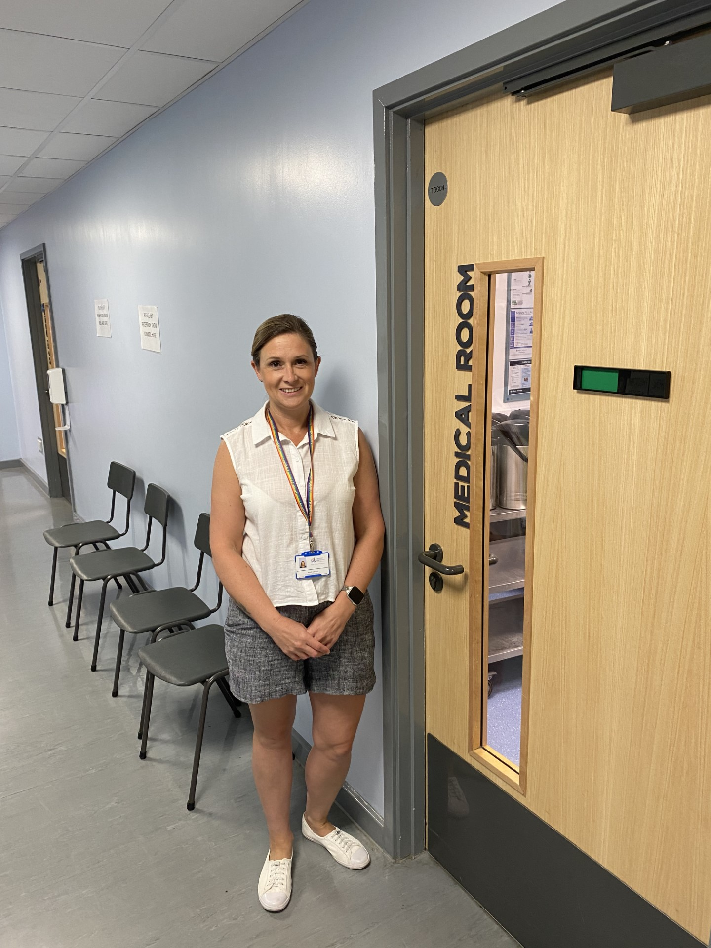
MEDICAL
ROOM
If students feel unwell during the day or need to take medication, they can visit the medical room.
They can come to the main reception at the front of school and ask to see one of our trained medical team where they will get the help they need.

Slide 11

FIRST AID
First Aid
If a child is unwell or hurts themselves they should go to reception for the medical staff to check if they are okay. One of the first aiders may contact parents/carers if they feel it is necessary. However, we are trying to develop their independence and resilience.
Students are not to contact parents/carers themselves
Illness
There is clear evidence that regular attendance and high achievement are linked. However, there may well be times when your child is too unwell to attend. If your child is unwell and therefore unable to attend school, it is essential to telephone the school on every day of absence, preferably by 8:30am. Please leave a message on our dedicated absence line: 01603 860505 option 1.
For absences of more than one day, parents/carers are asked to send an absence note with their child, even if a telephone call has already been made.

Slide 12

GETTING AROUND SCHOOL
Students may worry about finding their way around school, but I promise, it is not as confusing as it may seem. In a couple of weeks, everyone will know it like the back of their hand!
Lessons are organised in certain blocks or buildings and there are only 5 of them.
If you are ever unsure of where to go, just ask. Anyone will be happy to help!

Slide 13
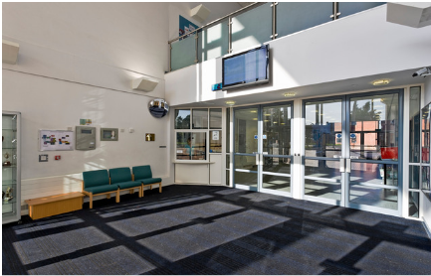
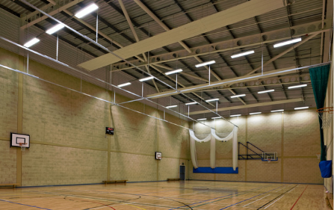
FIRST DAY
Only Y11 and 12
Will be in!
On their first day in September, students will not use the main entrance but will come into the Sports Hall instead.
Here they will meet their Form Tutor and will be taken to their Form Rooms to continue the transition.
They will be given a chance to get to know other members of their form, find key places in the school and partake in some introductory activities.

Slide 14
THS
TIMETABLE
08:25​ | - 08:30​ | Movement time​
08:30​ | - 09:35​ | Registration & Period 1​
09:35​ | - 10:35​ | Period 2​
10:35​ | - 10:55​ | Break​
10:55​ | - 11:55​ | Period 3​
11:55​ | - 12:55​ | Period 4​
12:55​ | - 13:35​ | Lunch​
13:35​ | - 13:40​ | Movement time​
13:40​ | - 14:00​ | Assembly and/or Form Time​
14:00​ | - 15:00​ | Period 5​
Try to come in for 8:10am, so you're not late!

Slide 15
THS LESSONS
There will be around 25-30 students in each class throughout the day
Students will be placed in sets based on their SAT's results – we will test again in the first half term and teachers can move students if needed
Students won't be in the same groups for all classes, and all form groups will be different from your other class groups

Slide 16
THS TIMETABLE
The name of your class group (this is a design & technology group).
Does everyone have the same timetable?
Everyone will do the same lessons over a fortnight (dependent on language choice) but not necessarily at the same time.
7L-DT1
1 Miss D Birkin
G10
The name of the teacher.
Which school period it is (1-5)
These may seem a little confusing at first but you will soon get the hang of it.
We work on a 2 week system so the lessons repeat every fortnight.
The timetable will give you the key information you will need for every session.
The room you will be in.

Slide 17
Tutor groups are random groups, as students will have a number of different subject learning groups, so it is important to make as many new friends as possible. The time spent in tutor groups is very low, it is around 20 minutes each day – this is tiny compared to the time spent in lessons!
There will be students from lots of different schools including (but not exclusively):
Taverham, Drayton, Queens Hill, Horsford, Hellesdon, St Peter’s & some from Home Education.
It is important that everyone feels included and students help one another make friends.
TUTOR
GROUPS

Slide 18
LEARNING
There are seven year groups in the school – Year 7 to Year 13. Within each year group students are divided into form groups with a Form Tutor. Year 7 will have 8 tutor groups – a mix from all the feeder schools. This is the chance to make new friends
In year 7 your child will study a wide range of subjects. These will be taught by
subject specialists:
English, Maths, Science, MFL, History, Geography, PD, RE, PE, Art, DT, Food Technology Music, Drama and Computer Science.
MFL: French, German, Spanish and Mandarin
Specialist rooms: Fully equipped science labs, purpose-built DT block, Food Technology suite, ICT facilities.
Teaching groups are not designed around friendship groups

Slide 19
TAVERHAM
HOMEWORK
We use the online system Satchel to record and set homework.
Reminders are set for students and you can view these at home via the website or on your phone via an app.
Students will also receive a diary to write down any set work.
How much Homework is there?
This will depend on which year group, the older students get, the more homework they get. In year 7 we look to set 30 minutes each day, which is 30 minutes per subject each fortnight.

Slide 20


COMMUNICATION
You can view key information on your child 24/7 via MCAS. This is an online portal that gives you access to key information from the school e.g. attendance, reports, negatives and positives.
The first named parental contact on the admissions form will be provided with a login and password at the start of the year. We will use the provided primary contact’s email address.
Communication from the school is emailed to parents.
Please let us know if your contact details change as soon as you can.
There will be 1 parents’ evening a year to meet with your child’s teachers.

Slide 21
COMMUNICATION
Leaving school during the day
If your child needs to leave school on any day, they must report to reception and sign the signing-out book before they go. They will not be allowed to leave school if you have not contacted the school prior to them leaving. You can ring the school, email or send a letter in with the student to be given in to reception. For the safety of our students, if we feel evidence is not legitimate, we will not let them leave.
You must send a letter in with the student, or have emailed the school if:
your child has been absent from school (even if a telephone message has already been given).
your child needs to leave school during the day for an appointment with a doctor or dentist, or for some other reason.
your child needs to be excused from PE.

Slide 22
THE HUB
If students need support with Literacy or Numeracy, they may have some lessons in the Hub. In these lessons, the staff will help with the things students find difficult, in lots of fun and interesting ways.
There is also Lego Therapy - Lego therapy has been shown to have helped many students with speech, language and communication difficulties. It helps to develop fine motor skills, and it’s FUN!
There are safe spaces upstairs by the HUB and the Head of Year's office, which students can go to. They will help to regulate student's emotions and is a safe space for a chat.

Slide 23
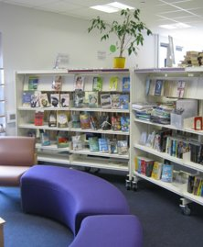
THE LIBRARY
What are the library opening times?
The library is open 8.15am – 3pm each day.
It can be used at breaks and lunches as well as being used for some English lessons and at form time.
We also have an after-school homework club 3pm – 4.30pm on a Monday – Thursday.
This is in an upstairs computer room rather than the library.
There’s lots to do in the library, it’s not just about books, there’s also: Games, monthly themed reading, Carnegie book award, Horrible Histories quiz and so much more!

Slide 24
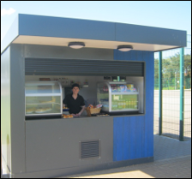
SCHOOL FOOD
The canteen staff make delicious fresh food, both hot and cold. If you have any dietary requirements just let them know. A cashless catering system (Wisepay) has been introduced so students do not need to bring money to school. Students can also bring a packed lunch. Food is available at break and lunch times both inside and outside.
Students can eat and hang out most places, as long as it's not in the corridors or classrooms. Most of these are locked during the day.

Slide 25
MOBILE PHONES
Students can bring a phone to school, but this must be switched off for the entire day - if you need to contact your child, please call reception and we will locate them during the day.
If a member of staff see's anyone with a phone in school, this will be confiscated, and a negative will be added to our system.
Students can collect this at the end of the day. If the phone is confiscated more than once, a parent/ carer will need to collect this at the end of the day, or this would be kept at school for 5 days.

Slide 26
Uniform
All students in Years 7 to 11 are expected to wear school uniform.
Skirts must be logoed, and knee length
Trousers must be tailored and black, and cannot be jeans or canvas type material.
Tailored, black, knee length school shorts can also be worn; they cannot be jeans or canvas type material.
Any coat that is worn should not bear offensive or derogatory writing or images and must not be worn in class, ‘hoodies’ are not permitted in school.
School shoes must be completely black and polishable.
We do have some second hand uniform available to purchase. Please contact the main office for further details.
SCHOOL
UNIFORM
Make-up and jewellery
The following items are acceptable in school:
A single or one pair of discreet stud earrings is allowed in the earlobe.
Discreet, natural make-up.
Natural nails, or natural looking with no long extensions.

Slide 27
CELEBRATING SUCCESS
The school’s behaviour policy is one of positive and productive learning environment which is underpinned by the work of Tom Bennett and linked to the work of Paul Dix: ‘The Five pillars of Pivotal practice.’
Students gain house points for good behaviour which are celebrated in form, assemblies and with communication home.
Student may also be celebrated for demonstrating our school values, taking part in clubs and activities and making a positive difference to our school community.
We also reward and recognize students with ‘awards evenings’ each year.
Students are also awarded for completing CORD activities which celebrate our four house values.
  E

Slide 28


CORD
CORD
Step 1:
Receive a task menu and stick it into your planner. Choose a task to try and complete (some might take you months, maybe even the whole year!)
Step 2:
Complete a task and during a fortnightly session in the computer rooms on Unifrog, log any completed tasks as ‘activities’ and wait to see if it is accepted.
Step 3:
Complete 5 tasks for each house value and receive a house value badge...
Complete 5 or more tasks for each value (20 tasks completed) and receive the CORD badge!
Great! How does it work?
Notes:
Students stick in task menu into planner (on a back page)
Students stick in CORD flow chart into planners (on a back page)
You may want to spend some time talking this through with students here or put Unifrog up and demonstrate how to log – equally, you may want to wait until session in computer rooms

Slide 29
BEHAVIOUR EXPECTATIONS
We want to make the school a positive learning environment for everyone and have a focus on eradicating low-level disruption to help achieve this. All teachers use a 3 step process to support this.​
Stage 1 - Student spoken to about expectations and student rectifies behaviour.​
Stage 2 - Becomes a negative behaviour event as low-level behaviour has continued but student remains in the lesson to improve behaviour. Event is entered on BromCom as a negative.​
Stage 3 - Remains a negative behaviour event but a 20-minute detention is issued with the class teacher as behaviour has continued and student will also be removed by COT to another classroom.
=
When excellent behaviour is demonstrated, both in and out of the lessons, you have the opportunity to gain positives. Positives mean you can earn yourself one of our fantastic star badges and earn special rewards. I want this year group to lead the way for kindness and good behaviour, but this will take everybody working together.

Slide 30
WHAT'S THE AIM?
We want, what you want...
For your child/ward to be:
HAPPY
KIND AND COMPASSIONATE
SUCCESSFUL AND AMBITIOUS
Ultimately, for them to be able to go on to be happy, successful, contributing members of the community!

Slide 31
d.birkin@taverhamhigh.org - Head of Year 7
t.gardiner@taverhamhigh.org - Transition Lead
THSsenco@taverhamhigh.org - SENCO
s.derrick@taverhamhigh.org

